Slide 1
Tugas Data Mining
Nama : Hadapininglaksmi Astri P
Nim : A11.2017.10391
Klmpk : A11.4604
Data Mining

Slide 2
Latihan
Hitung Entropy dan Gain serta tentukan pohon keputusan yang terbentuk dari contoh kasus keputusan bermain tenis dibawah ini :
NO | OUTLOOK | TEMPERATURE | HUMIDITY | WINDY | PLAY
1 | Sunny | Hot | High | No | Don’t Play
2 | Sunny | Hot | High | Yes | Don’t Play
3 | Cloudy | Hot | High | No | Play
4 | Rainy | Mild | High | No | Play
5 | Rainy | Cool | Normal | No | Play
6 | Rainy | Cool | Normal | Yes | Play
7 | Cloudy | Cool | Normal | Yes | Play
8 | Sunny | Mild | High | No | Don’t Play
9 | Sunny | Cool | Normal | No | Play
10 | Rainy | Mild | Normal | No | Play
11 | Sunny | Mild | Normal | Yes | Play
12 | Cloudy | Mild | High | Yes | Play
13 | Cloudy | Hot | Normal | No | Play
14 | Rainy | Mild | High | Yes | Don’t Play

Slide 3

Entropy
Perhitungan nilai entropy berdasarkan rumus :
Entropy (S) =
S : Himpunan Kasus
N : Jumlah Partisi dalam S
Pi : Proporsi dari Si terhadap S
$$\sum_{i=1}^{n}{− pi ∗ \log_{2}pi}$$

Slide 4

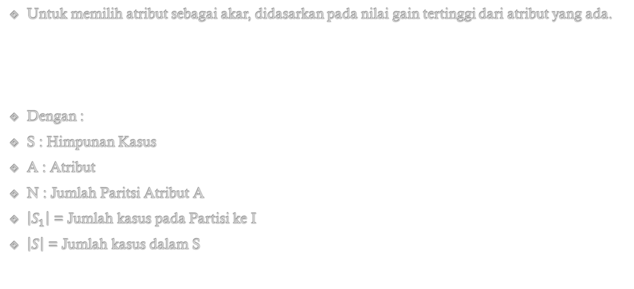
Gain
Untuk memilih atribut sebagai akar, didasarkan pada nilai gain tertinggi dari atribut yang ada.
Dengan :
S : Himpunan Kasus
A : Atribut
N : Jumlah Paritsi Atribut A
$\left|S_{1}\right|$ = Jumlah kasus pada Partisi ke I
$\left|S\right|$ = Jumlah kasus dalam S
$$Gain \left(S, A\right)=Entropy \left(S\right)− \sum_{i=1}^{n}{\frac{\left|S_{1}\right|}{\left|S\right|}∗Entropy (S)}$$

Slide 5
Penyelesaian 1
Menghitung jumlah kasus, jumlah kasus yang play, jumlah kasus yang don’t play dan entropy
NO | OUTLOOK | TEMPERATURE | HUMIDITY | WINDY | PLAY
1 | Sunny | Hot | High | No | Don’t Play
2 | Sunny | Hot | High | Yes | Don’t Play
3 | Cloudy | Hot | High | No | Play
4 | Rainy | Mild | High | No | Play
5 | Rainy | Cool | Normal | No | Play
6 | Rainy | Cool | Normal | Yes | Play
7 | Cloudy | Cool | Normal | Yes | Play
8 | Sunny | Mild | High | No | Don’t Play
9 | Sunny | Cool | Normal | No | Play
10 | Rainy | Mild | Normal | No | Play
11 | Sunny | Mild | Normal | Yes | Play
12 | Cloudy | Mild | High | Yes | Play
13 | Cloudy | Hot | Normal | No | Play
14 | Rainy | Mild | High | Yes | Don’t Play

Slide 6
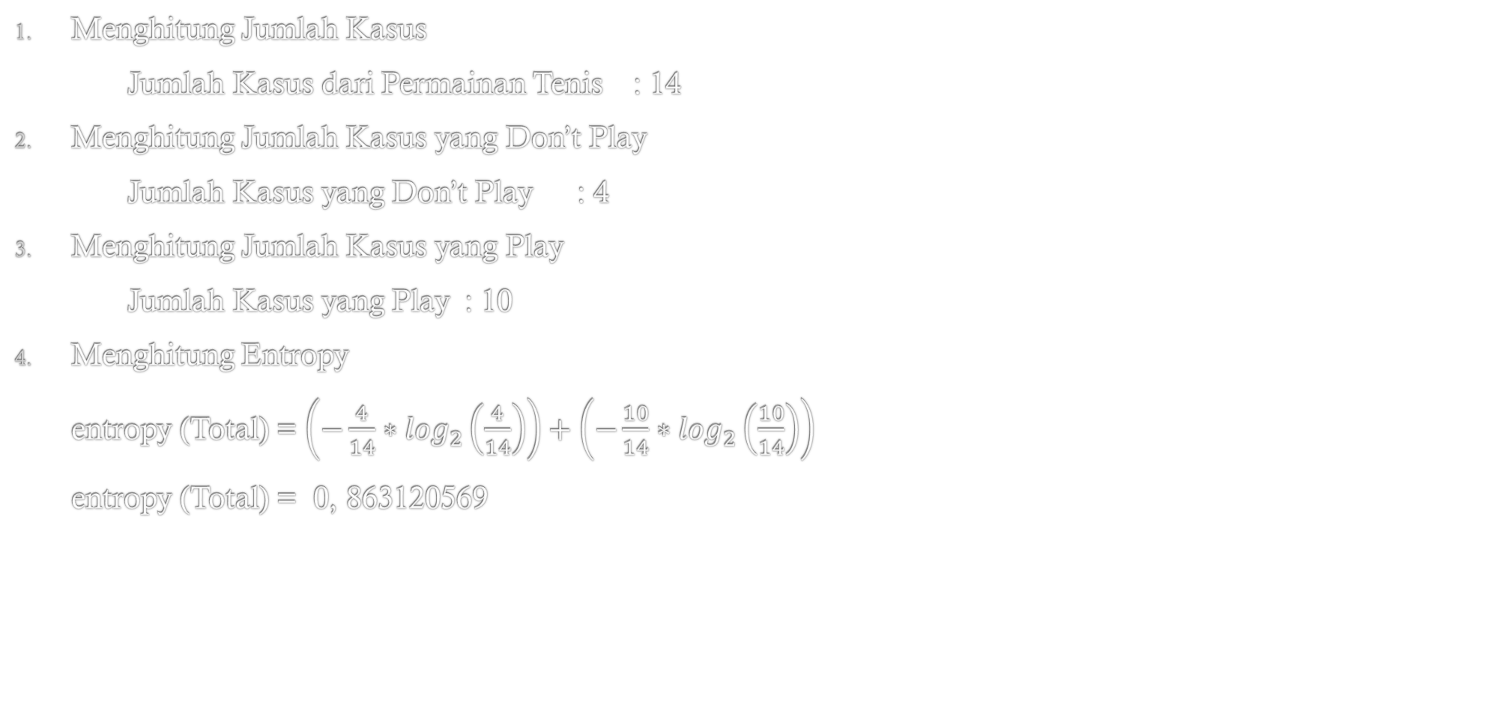
Penyelesaian 1a
Menghitung Jumlah Kasus
Jumlah Kasus dari Permainan Tenis : 14
Menghitung Jumlah Kasus yang Don’t Play
Jumlah Kasus yang Don’t Play : 4
Menghitung Jumlah Kasus yang Play
Jumlah Kasus yang Play : 10
Menghitung Entropy
entropy (Total) = $\left(−\frac{4}{14}∗\log_{2}\left(\frac{4}{14}\right)\right)+\left(−\frac{10}{14}∗\log_{2}\left(\frac{10}{14}\right)\right)$
entropy (Total) = 0, 863120569

Slide 7
Penyelesaian 2
Menghitung kasus berdasarkan atribut Outlook Sunny, Cloudy dan Rainy
NO | OUTLOOK | TEMPERATURE | HUMIDITY | WINDY | PLAY
1 | Sunny | Hot | High | No | Don’t Play
2 | Sunny | Hot | High | Yes | Don’t Play
3 | Cloudy | Hot | High | No | Play
4 | Rainy | Mild | High | No | Play
5 | Rainy | Cool | Normal | No | Play
6 | Rainy | Cool | Normal | Yes | Play
7 | Cloudy | Cool | Normal | Yes | Play
8 | Sunny | Mild | High | No | Don’t Play
9 | Sunny | Cool | Normal | No | Play
10 | Rainy | Mild | Normal | No | Play
11 | Sunny | Mild | Normal | Yes | Play
12 | Cloudy | Mild | High | Yes | Play
13 | Cloudy | Hot | Normal | No | Play
14 | Rainy | Mild | High | Yes | Don’t Play

Slide 8
Penyelesaian 2a
Menghitung kasus berdasarkan atribut Outlook Cloudy
NO | OUTLOOK | TEMPERATURE | HUMIDITY | WINDY | PLAY
1 | Sunny | Hot | High | No | Don’t Play
2 | Sunny | Hot | High | Yes | Don’t Play
3 | Cloudy | Hot | High | No | Play
4 | Rainy | Mild | High | No | Play
5 | Rainy | Cool | Normal | No | Play
6 | Rainy | Cool | Normal | Yes | Play
7 | Cloudy | Cool | Normal | Yes | Play
8 | Sunny | Mild | High | No | Don’t Play
9 | Sunny | Cool | Normal | No | Play
10 | Rainy | Mild | Normal | No | Play
11 | Sunny | Mild | Normal | Yes | Play
12 | Cloudy | Mild | High | Yes | Play
13 | Cloudy | Hot | Normal | No | Play
14 | Rainy | Mild | High | Yes | Don’t Play

Slide 9
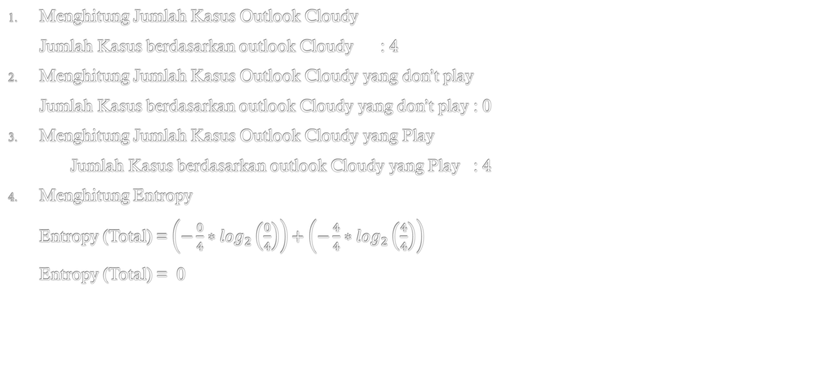
Penyelesaian 2a. Outlook Cloudy
Menghitung Jumlah Kasus Outlook Cloudy
Jumlah Kasus berdasarkan outlook Cloudy : 4
Menghitung Jumlah Kasus Outlook Cloudy yang don’t play
Jumlah Kasus berdasarkan outlook Cloudy yang don’t play : 0
Menghitung Jumlah Kasus Outlook Cloudy yang Play
Jumlah Kasus berdasarkan outlook Cloudy yang Play : 4
Menghitung Entropy
Entropy (Total) = $\left(−\frac{0}{4}∗\log_{2}\left(\frac{0}{4}\right)\right)+\left(−\frac{4}{4}∗\log_{2}\left(\frac{4}{4}\right)\right)$
Entropy (Total) = 0

Slide 10
Penyelesaian 2b
Menghitung kasus berdasarkan atribut Outlook Rainy
NO | OUTLOOK | TEMPERATURE | HUMIDITY | WINDY | PLAY
1 | Sunny | Hot | High | No | Don’t Play
2 | Sunny | Hot | High | Yes | Don’t Play
3 | Cloudy | Hot | High | No | Play
4 | Rainy | Mild | High | No | Play
5 | Rainy | Cool | Normal | No | Play
6 | Rainy | Cool | Normal | Yes | Play
7 | Cloudy | Cool | Normal | Yes | Play
8 | Sunny | Mild | High | No | Don’t Play
9 | Sunny | Cool | Normal | No | Play
10 | Rainy | Mild | Normal | No | Play
11 | Sunny | Mild | Normal | Yes | Play
12 | Cloudy | Mild | High | Yes | Play
13 | Cloudy | Hot | Normal | No | Play
14 | Rainy | Mild | High | Yes | Don’t Play

Slide 11
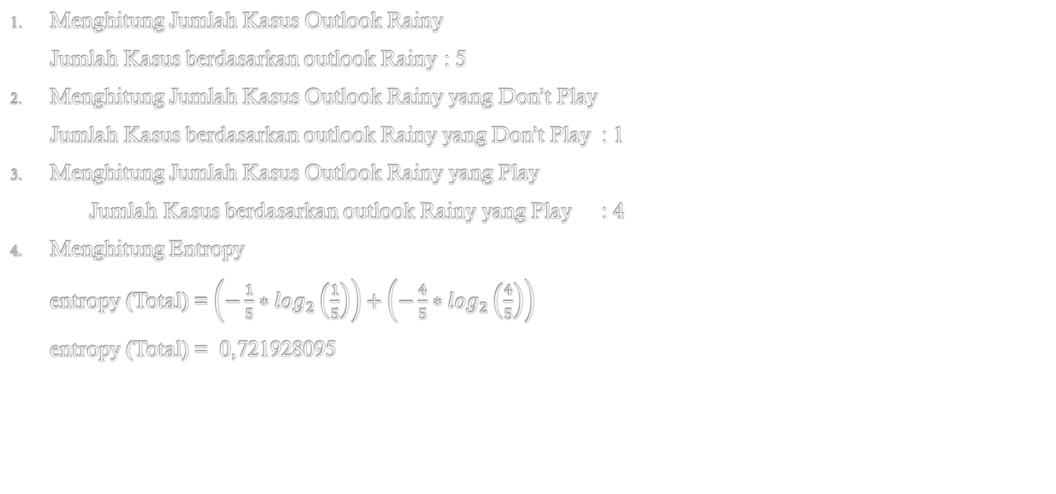
Penyelesaian 2b. Outlook Rainy
Menghitung Jumlah Kasus Outlook Rainy
Jumlah Kasus berdasarkan outlook Rainy : 5
Menghitung Jumlah Kasus Outlook Rainy yang Don’t Play
Jumlah Kasus berdasarkan outlook Rainy yang Don’t Play : 1
Menghitung Jumlah Kasus Outlook Rainy yang Play
Jumlah Kasus berdasarkan outlook Rainy yang Play : 4
Menghitung Entropy
entropy (Total) = $\left(−\frac{1}{5}∗\log_{2}\left(\frac{1}{5}\right)\right)+\left(−\frac{4}{5}∗\log_{2}\left(\frac{4}{5}\right)\right)$
entropy (Total) = 0,721928095

Slide 12
Penyelesaian 2b
Menghitung kasus berdasarkan atribut Outlook Sunny
NO | OUTLOOK | TEMPERATURE | HUMIDITY | WINDY | PLAY
1 | Sunny | Hot | High | No | Don’t Play
2 | Sunny | Hot | High | Yes | Don’t Play
3 | Cloudy | Hot | High | No | Play
4 | Rainy | Mild | High | No | Play
5 | Rainy | Cool | Normal | No | Play
6 | Rainy | Cool | Normal | Yes | Play
7 | Cloudy | Cool | Normal | Yes | Play
8 | Sunny | Mild | High | No | Don’t Play
9 | Sunny | Cool | Normal | No | Play
10 | Rainy | Mild | Normal | No | Play
11 | Sunny | Mild | Normal | Yes | Play
12 | Cloudy | Mild | High | Yes | Play
13 | Cloudy | Hot | Normal | No | Play
14 | Rainy | Mild | High | Yes | Don’t Play

Slide 13
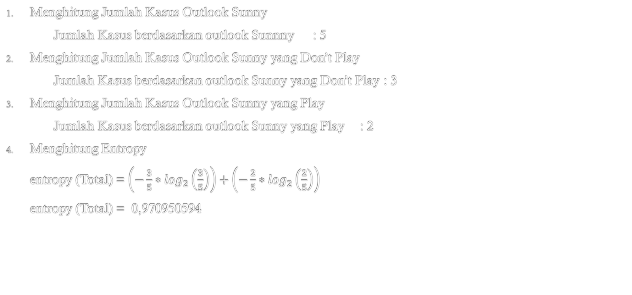
Penyelesaian 2c. Outlook Sunny
Menghitung Jumlah Kasus Outlook Sunny
Jumlah Kasus berdasarkan outlook Sunnny : 5
Menghitung Jumlah Kasus Outlook Sunny yang Don’t Play
Jumlah Kasus berdasarkan outlook Sunny yang Don’t Play : 3
Menghitung Jumlah Kasus Outlook Sunny yang Play
Jumlah Kasus berdasarkan outlook Sunny yang Play : 2
Menghitung Entropy
entropy (Total) = $\left(−\frac{3}{5}∗\log_{2}\left(\frac{3}{5}\right)\right)+\left(−\frac{2}{5}∗\log_{2}\left(\frac{2}{5}\right)\right)$
entropy (Total) = 0,970950594

Slide 14



Penyelesaian 2d. Gain Outlook
$$Gain \left(Total, Outlook\right)=Entropy \left(Total\right)− \sum_{i=1}^{n}{\frac{\left|Outlook\right|}{\left|Entropy\right|}∗Entropy (outlook)}$$
$$Gain \left(Total, Outlook\right)=0,863120569−\left(\left(\frac{4}{14}∗0\right)+\left(\frac{5}{14}∗0,72193\right)+\left(\frac{5}{14}∗0,970095\right)\right)$$
$$Gain \left(Total, Outlook\right)=0, 258521039$$

Slide 15
Penyelesaian 3
Menghitung kasus berdasarkan atribut Temperature Hot, Mild, Cool
NO | OUTLOOK | TEMPERATURE | HUMIDITY | WINDY | PLAY
1 | Sunny | Hot | High | No | Don’t Play
2 | Sunny | Hot | High | Yes | Don’t Play
3 | Cloudy | Hot | High | No | Play
4 | Rainy | Mild | High | No | Play
5 | Rainy | Cool | Normal | No | Play
6 | Rainy | Cool | Normal | Yes | Play
7 | Cloudy | Cool | Normal | Yes | Play
8 | Sunny | Mild | High | No | Don’t Play
9 | Sunny | Cool | Normal | No | Play
10 | Rainy | Mild | Normal | No | Play
11 | Sunny | Mild | Normal | Yes | Play
12 | Cloudy | Mild | High | Yes | Play
13 | Cloudy | Hot | Normal | No | Play
14 | Rainy | Mild | High | Yes | Don’t Play

Slide 16
Penyelesaian 3a
Menghitung kasus berdasarkan atribut Temperature Hot
NO | OUTLOOK | TEMPERATURE | HUMIDITY | WINDY | PLAY
1 | Sunny | Hot | High | No | Don’t Play
2 | Sunny | Hot | High | Yes | Don’t Play
3 | Cloudy | Hot | High | No | Play
4 | Rainy | Mild | High | No | Play
5 | Rainy | Cool | Normal | No | Play
6 | Rainy | Cool | Normal | Yes | Play
7 | Cloudy | Cool | Normal | Yes | Play
8 | Sunny | Mild | High | No | Don’t Play
9 | Sunny | Cool | Normal | No | Play
10 | Rainy | Mild | Normal | No | Play
11 | Sunny | Mild | Normal | Yes | Play
12 | Cloudy | Mild | High | Yes | Play
13 | Cloudy | Hot | Normal | No | Play
14 | Rainy | Mild | High | Yes | Don’t Play

Slide 17
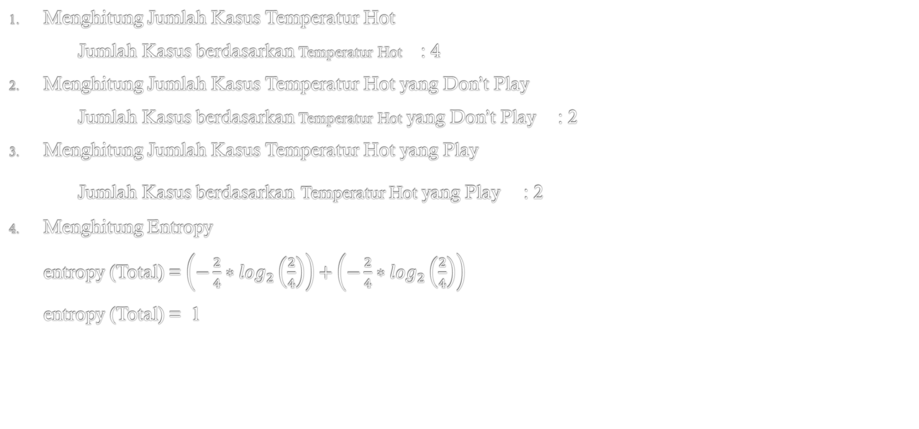
Penyelesaian 3a. Temperature Hot
Menghitung Jumlah Kasus Temperatur Hot
Jumlah Kasus berdasarkan Temperatur Hot : 4
Menghitung Jumlah Kasus Temperatur Hot yang Don’t Play
Jumlah Kasus berdasarkan Temperatur Hot yang Don’t Play : 2
Menghitung Jumlah Kasus Temperatur Hot yang Play
Jumlah Kasus berdasarkan Temperatur Hot yang Play : 2
Menghitung Entropy
entropy (Total) = $\left(−\frac{2}{4}∗\log_{2}\left(\frac{2}{4}\right)\right)+\left(−\frac{2}{4}∗\log_{2}\left(\frac{2}{4}\right)\right)$
entropy (Total) = 1

Slide 18
Penyelesaian 3b
Menghitung kasus berdasarkan atribut Temperature Mild
NO | OUTLOOK | TEMPERATURE | HUMIDITY | WINDY | PLAY
1 | Sunny | Hot | High | No | Don’t Play
2 | Sunny | Hot | High | Yes | Don’t Play
3 | Cloudy | Hot | High | No | Play
4 | Rainy | Mild | High | No | Play
5 | Rainy | Cool | Normal | No | Play
6 | Rainy | Cool | Normal | Yes | Play
7 | Cloudy | Cool | Normal | Yes | Play
8 | Sunny | Mild | High | No | Don’t Play
9 | Sunny | Cool | Normal | No | Play
10 | Rainy | Mild | Normal | No | Play
11 | Sunny | Mild | Normal | Yes | Play
12 | Cloudy | Mild | High | Yes | Play
13 | Cloudy | Hot | Normal | No | Play
14 | Rainy | Mild | High | Yes | Don’t Play

Slide 19
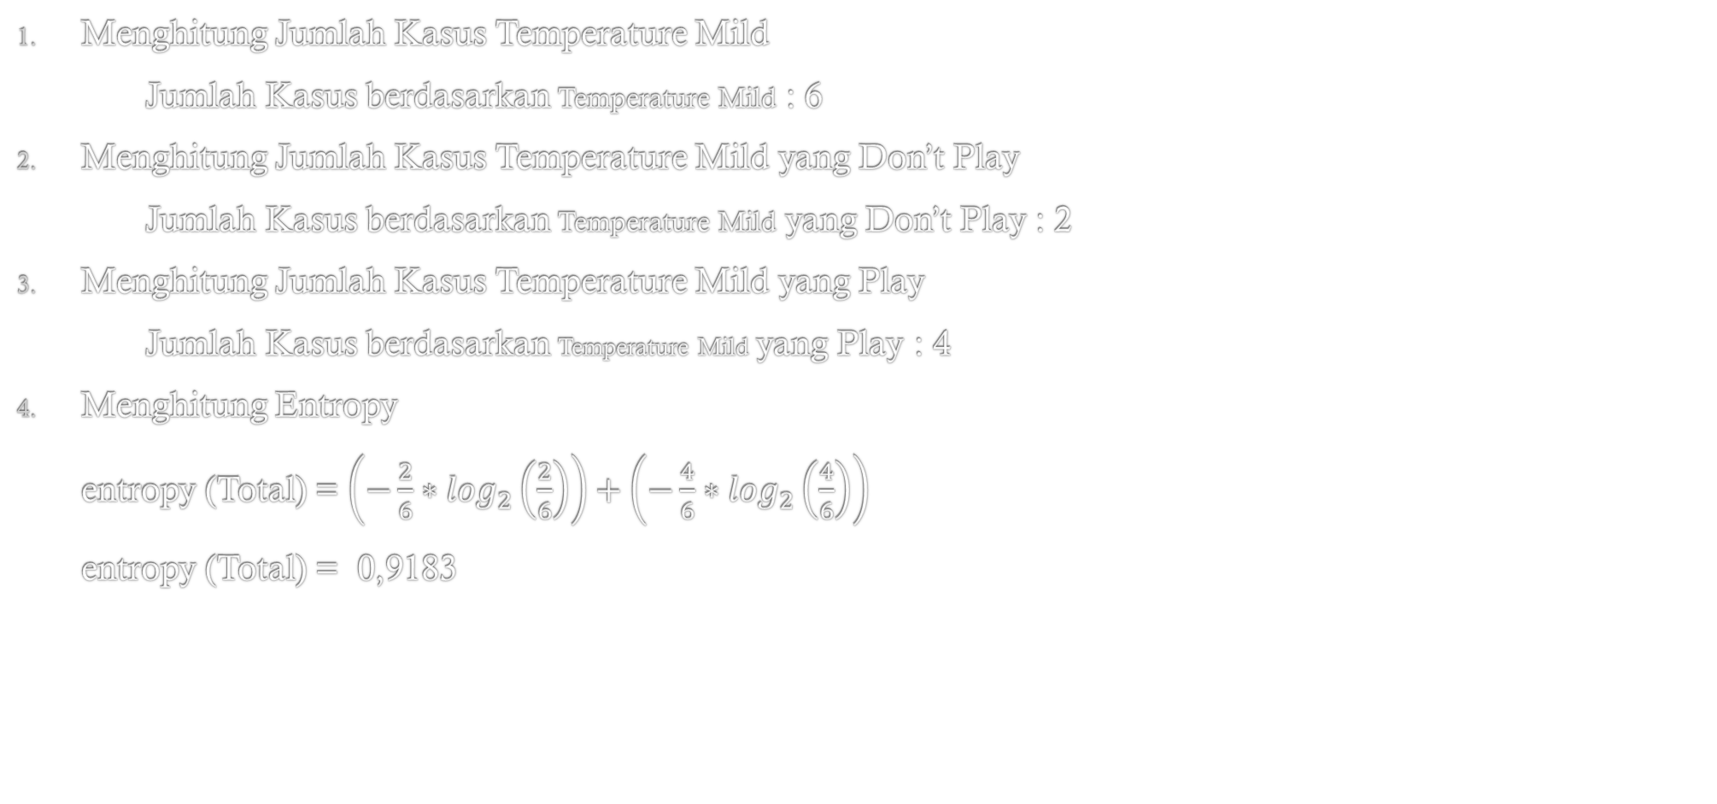
Penyelesaian Temperature Mild
Menghitung Jumlah Kasus Temperature Mild
Jumlah Kasus berdasarkan Temperature Mild : 6
Menghitung Jumlah Kasus Temperature Mild yang Don’t Play
Jumlah Kasus berdasarkan Temperature Mild yang Don’t Play : 2
Menghitung Jumlah Kasus Temperature Mild yang Play
Jumlah Kasus berdasarkan Temperature Mild yang Play : 4
Menghitung Entropy
entropy (Total) = $\left(−\frac{2}{6}∗\log_{2}\left(\frac{2}{6}\right)\right)+\left(−\frac{4}{6}∗\log_{2}\left(\frac{4}{6}\right)\right)$
entropy (Total) = 0,9183

Slide 20
Penyelesaian 3c
Menghitung kasus berdasarkan atribut Outlook Sunny
NO | OUTLOOK | TEMPERATURE | HUMIDITY | WINDY | PLAY
1 | Sunny | Hot | High | No | Don’t Play
2 | Sunny | Hot | High | Yes | Don’t Play
3 | Cloudy | Hot | High | No | Play
4 | Rainy | Mild | High | No | Play
5 | Rainy | Cool | Normal | No | Play
6 | Rainy | Cool | Normal | Yes | Play
7 | Cloudy | Cool | Normal | Yes | Play
8 | Sunny | Mild | High | No | Don’t Play
9 | Sunny | Cool | Normal | No | Play
10 | Rainy | Mild | Normal | No | Play
11 | Sunny | Mild | Normal | Yes | Play
12 | Cloudy | Mild | High | Yes | Play
13 | Cloudy | Hot | Normal | No | Play
14 | Rainy | Mild | High | Yes | Don’t Play

Slide 21
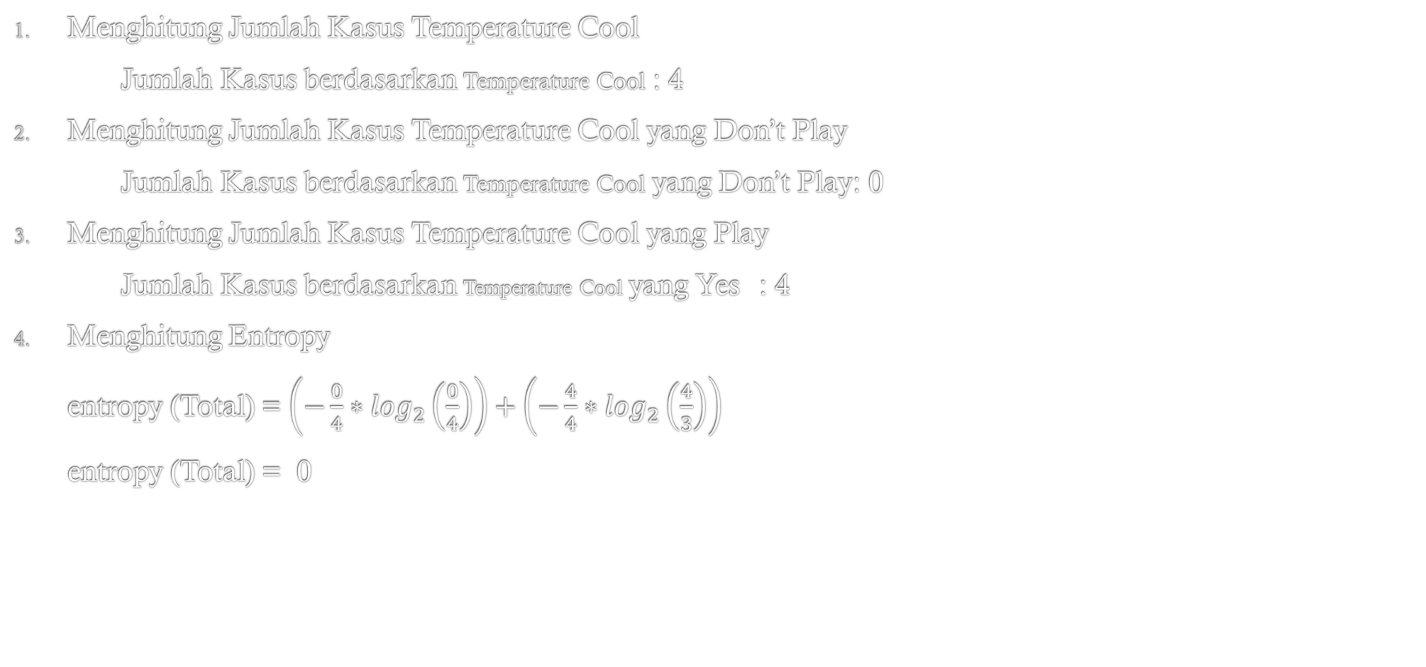
Penyelesaian 3c. Temperature Cool
Menghitung Jumlah Kasus Temperature Cool
Jumlah Kasus berdasarkan Temperature Cool : 4
Menghitung Jumlah Kasus Temperature Cool yang Don’t Play
Jumlah Kasus berdasarkan Temperature Cool yang Don’t Play: 0
Menghitung Jumlah Kasus Temperature Cool yang Play
Jumlah Kasus berdasarkan Temperature Cool yang Yes : 4
Menghitung Entropy
entropy (Total) = $\left(−\frac{0}{4}∗\log_{2}\left(\frac{0}{4}\right)\right)+\left(−\frac{4}{4}∗\log_{2}\left(\frac{4}{3}\right)\right)$
entropy (Total) = 0

Slide 22



Penyelesaian 3d. Gain Temperature
$$Gain \left(Total, Temperature\right)=Entropy \left(Total\right)− \sum_{i=1}^{n}{\frac{\left|Outlook\right|}{\left|Entropy\right|}∗Entropy (Temperature)}$$
$$Gain \left(Total, Temperature\right)=0,863120569−\left(\left(\frac{4}{14}∗1\right)+\left(\frac{6}{14}∗0,918883\right)+\left(\frac{4}{14}∗0\right)\right)$$
$$Gain \left(Total, Temperature\right)=0, 1838509$$

Slide 23
Penyelesaian 4
Menghitung kasus berdasarkan atribut Humidity Hight, Normal
NO | OUTLOOK | TEMPERATURE | HUMIDITY | WINDY | PLAY
1 | Sunny | Hot | High | No | Don’t Play
2 | Sunny | Hot | High | Yes | Don’t Play
3 | Cloudy | Hot | High | No | Play
4 | Rainy | Mild | High | No | Play
5 | Rainy | Cool | Normal | No | Play
6 | Rainy | Cool | Normal | Yes | Play
7 | Cloudy | Cool | Normal | Yes | Play
8 | Sunny | Mild | High | No | Don’t Play
9 | Sunny | Cool | Normal | No | Play
10 | Rainy | Mild | Normal | No | Play
11 | Sunny | Mild | Normal | Yes | Play
12 | Cloudy | Mild | High | Yes | Play
13 | Cloudy | Hot | Normal | No | Play
14 | Rainy | Mild | High | Yes | Don’t Play

Slide 24
Penyelesaian 4a
Menghitung kasus berdasarkan atribut Humidity High
NO | OUTLOOK | TEMPERATURE | HUMIDITY | WINDY | PLAY
1 | Sunny | Hot | High | No | Don’t Play
2 | Sunny | Hot | High | Yes | Don’t Play
3 | Cloudy | Hot | High | No | Play
4 | Rainy | Mild | High | No | Play
5 | Rainy | Cool | Normal | No | Play
6 | Rainy | Cool | Normal | Yes | Play
7 | Cloudy | Cool | Normal | Yes | Play
8 | Sunny | Mild | High | No | Don’t Play
9 | Sunny | Cool | Normal | No | Play
10 | Rainy | Mild | Normal | No | Play
11 | Sunny | Mild | Normal | Yes | Play
12 | Cloudy | Mild | High | Yes | Play
13 | Cloudy | Hot | Normal | No | Play
14 | Rainy | Mild | High | Yes | Don’t Play

Slide 25
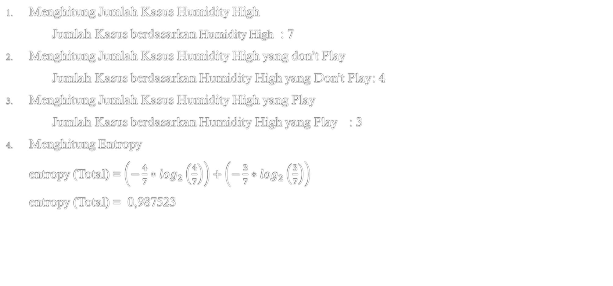
Penyelesaian 4a. Humidity High
Menghitung Jumlah Kasus Humidity High
Jumlah Kasus berdasarkan Humidity High : 7
Menghitung Jumlah Kasus Humidity High yang don’t Play
Jumlah Kasus berdasarkan Humidity High yang Don’t Play : 4
Menghitung Jumlah Kasus Humidity High yang Play
Jumlah Kasus berdasarkan Humidity High yang Play : 3
Menghitung Entropy
entropy (Total) = $\left(−\frac{4}{7}∗\log_{2}\left(\frac{4}{7}\right)\right)+\left(−\frac{3}{7}∗\log_{2}\left(\frac{3}{7}\right)\right)$
entropy (Total) = 0,987523

Slide 26
Penyelesaian 4b
Menghitung kasus berdasarkan atribut Humidity Normal
NO | OUTLOOK | TEMPERATURE | HUMIDITY | WINDY | PLAY
1 | Sunny | Hot | High | No | Don’t Play
2 | Sunny | Hot | High | Yes | Don’t Play
3 | Cloudy | Hot | High | No | Play
4 | Rainy | Mild | High | No | Play
5 | Rainy | Cool | Normal | No | Play
6 | Rainy | Cool | Normal | Yes | Play
7 | Cloudy | Cool | Normal | Yes | Play
8 | Sunny | Mild | High | No | Don’t Play
9 | Sunny | Cool | Normal | No | Play
10 | Rainy | Mild | Normal | No | Play
11 | Sunny | Mild | Normal | Yes | Play
12 | Cloudy | Mild | High | Yes | Play
13 | Cloudy | Hot | Normal | No | Play
14 | Rainy | Mild | High | Yes | Don’t Play

Slide 27
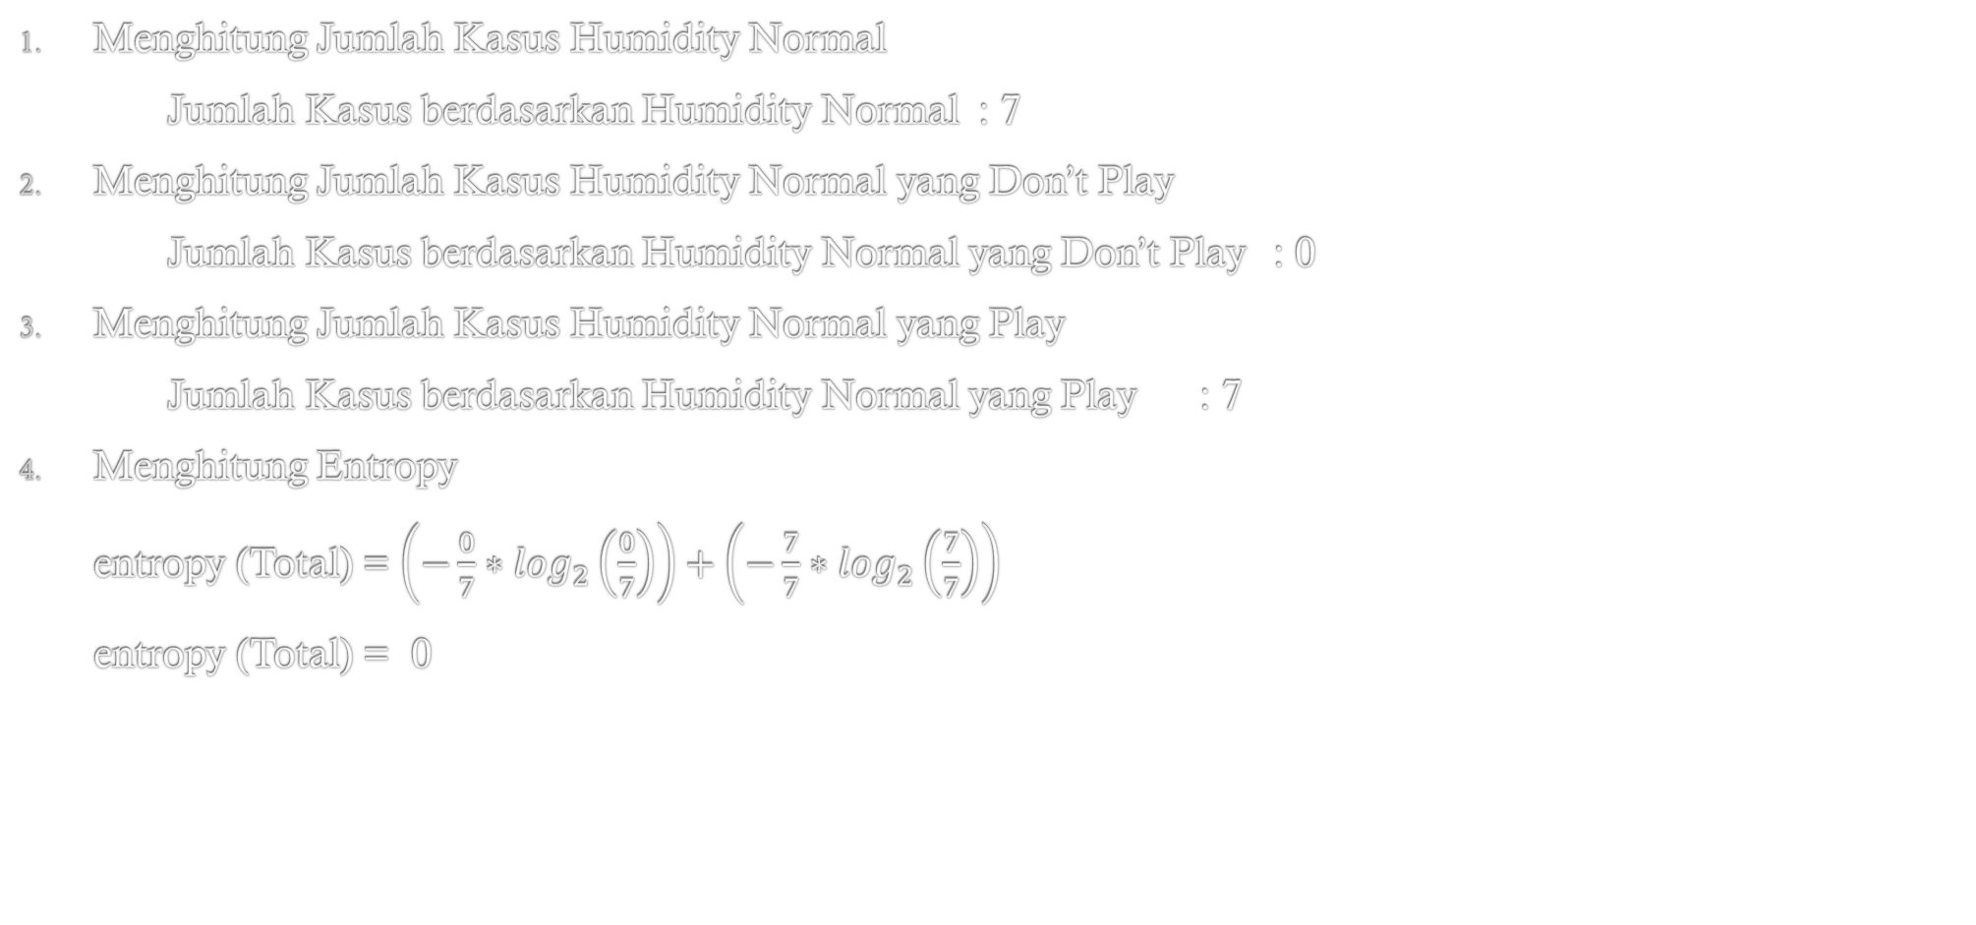
Penyelesaian 4b. Humidity Normal
Menghitung Jumlah Kasus Humidity Normal
Jumlah Kasus berdasarkan Humidity Normal : 7
Menghitung Jumlah Kasus Humidity Normal yang Don’t Play
Jumlah Kasus berdasarkan Humidity Normal yang Don’t Play : 0
Menghitung Jumlah Kasus Humidity Normal yang Play
Jumlah Kasus berdasarkan Humidity Normal yang Play : 7
Menghitung Entropy
entropy (Total) = $\left(−\frac{0}{7}∗\log_{2}\left(\frac{0}{7}\right)\right)+\left(−\frac{7}{7}∗\log_{2}\left(\frac{7}{7}\right)\right)$
entropy (Total) = 0

Slide 28



Penyelesaian 4d. Gain Humidity
$$Gain \left(Total, Humidity\right)=Entropy \left(Total\right)− \sum_{i=1}^{n}{\frac{\left|Outlook\right|}{\left|Entropy\right|}∗Entropy (outlook)}$$
$$Gain \left(Total, Humidity\right)=0,863120569−\left(\left(\frac{7}{14}∗0,98523\right)+\left(\frac{7}{14}∗0\right)\right)$$
$$Gain \left(Total, Humidity\right)=0, 37$$

Slide 29
Penyelesaian 5
Menghitung kasus berdasarkan atribut Windy Yes, No
NO | OUTLOOK | TEMPERATURE | HUMIDITY | WINDY | PLAY
1 | Sunny | Hot | High | No | Don’t Play
2 | Sunny | Hot | High | Yes | Don’t Play
3 | Cloudy | Hot | High | No | Play
4 | Rainy | Mild | High | No | Play
5 | Rainy | Cool | Normal | No | Play
6 | Rainy | Cool | Normal | Yes | Play
7 | Cloudy | Cool | Normal | Yes | Play
8 | Sunny | Mild | High | No | Don’t Play
9 | Sunny | Cool | Normal | No | Play
10 | Rainy | Mild | Normal | No | Play
11 | Sunny | Mild | Normal | Yes | Play
12 | Cloudy | Mild | High | Yes | Play
13 | Cloudy | Hot | Normal | No | Play
14 | Rainy | Mild | High | Yes | Don’t Play

Slide 30
Penyelesaian 5a
Menghitung kasus berdasarkan atribut Windy Yes
NO | OUTLOOK | TEMPERATURE | HUMIDITY | WINDY | PLAY
1 | Sunny | Hot | High | No | Don’t Play
2 | Sunny | Hot | High | Yes | Don’t Play
3 | Cloudy | Hot | High | No | Play
4 | Rainy | Mild | High | No | Play
5 | Rainy | Cool | Normal | No | Play
6 | Rainy | Cool | Normal | Yes | Play
7 | Cloudy | Cool | Normal | Yes | Play
8 | Sunny | Mild | High | No | Don’t Play
9 | Sunny | Cool | Normal | No | Play
10 | Rainy | Mild | Normal | No | Play
11 | Sunny | Mild | Normal | Yes | Play
12 | Cloudy | Mild | High | Yes | Play
13 | Cloudy | Hot | Normal | No | Play
14 | Rainy | Mild | High | Yes | Don’t Play

Slide 31
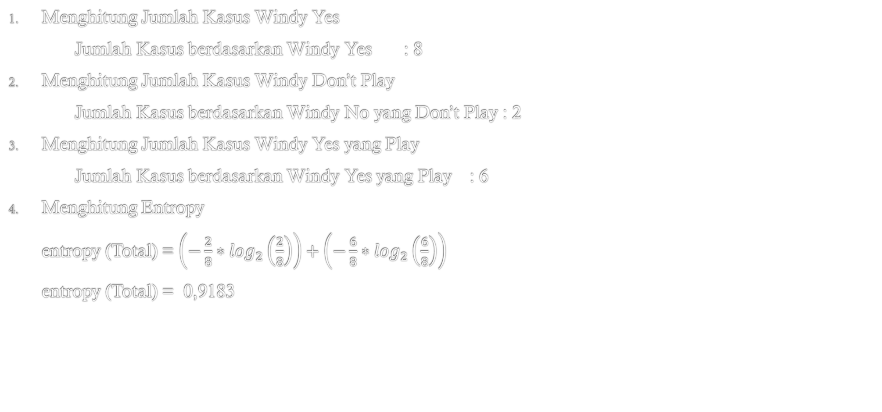
Penyelesaian 5a. Windy Yes
Menghitung Jumlah Kasus Windy Yes
Jumlah Kasus berdasarkan Windy Yes : 8
Menghitung Jumlah Kasus Windy Don’t Play
Jumlah Kasus berdasarkan Windy No yang Don’t Play : 2
Menghitung Jumlah Kasus Windy Yes yang Play
Jumlah Kasus berdasarkan Windy Yes yang Play : 6
Menghitung Entropy
entropy (Total) = $\left(−\frac{2}{8}∗\log_{2}\left(\frac{2}{8}\right)\right)+\left(−\frac{6}{8}∗\log_{2}\left(\frac{6}{8}\right)\right)$
entropy (Total) = 0,9183

Slide 32
Penyelesaian 5b
Menghitung kasus berdasarkan atribut Windy No
NO | OUTLOOK | TEMPERATURE | HUMIDITY | WINDY | PLAY
1 | Sunny | Hot | High | No | Don’t Play
2 | Sunny | Hot | High | Yes | Don’t Play
3 | Cloudy | Hot | High | No | Play
4 | Rainy | Mild | High | No | Play
5 | Rainy | Cool | Normal | No | Play
6 | Rainy | Cool | Normal | Yes | Play
7 | Cloudy | Cool | Normal | Yes | Play
8 | Sunny | Mild | High | No | Don’t Play
9 | Sunny | Cool | Normal | No | Play
10 | Rainy | Mild | Normal | No | Play
11 | Sunny | Mild | Normal | Yes | Play
12 | Cloudy | Mild | High | Yes | Play
13 | Cloudy | Hot | Normal | No | Play
14 | Rainy | Mild | High | Yes | Don’t Play

Slide 33
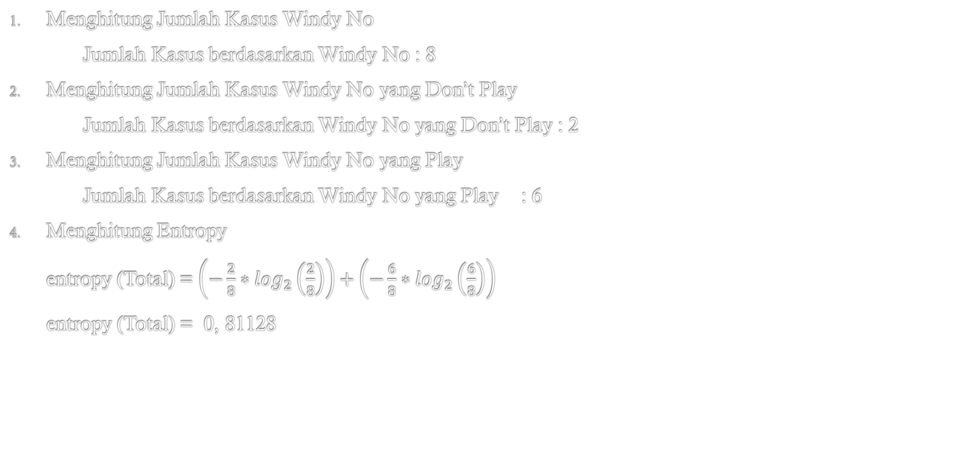
Penyelesaian 5b. Windy No
Menghitung Jumlah Kasus Windy No
Jumlah Kasus berdasarkan Windy No : 8
Menghitung Jumlah Kasus Windy No yang Don’t Play
Jumlah Kasus berdasarkan Windy No yang Don’t Play : 2
Menghitung Jumlah Kasus Windy No yang Play
Jumlah Kasus berdasarkan Windy No yang Play : 6
Menghitung Entropy
entropy (Total) = $\left(−\frac{2}{8}∗\log_{2}\left(\frac{2}{8}\right)\right)+\left(−\frac{6}{8}∗\log_{2}\left(\frac{6}{8}\right)\right)$
entropy (Total) = 0, 81128

Slide 34



Penyelesaian 5c. Gain Windy
$$Gain \left(Total, Windy\right)=Entropy \left(Total\right)− \sum_{i=1}^{n}{\frac{\left|Outlook\right|}{\left|Entropy\right|}∗Entropy (Windy)}$$
$$Gain \left(Total,Windy\right)=0,863120569−\left(\left(\frac{8}{14}∗0,81128\right)+\left(\frac{6}{14}∗0,9183\right)\right)$$
$$Gain \left(Total,Windy\right)=0, 0059777$$

Slide 35
Hasil Perhitungan Entropy dan Gain
Node | Atribut | Value | Jumlah Kasus (S) | NO (S1) | Yes(S2) | Entropy | Gain
1 | Total |  | 14 | 4 | 10 | 0,863120569
 | Outlook |  |  |  |  |  | 0,258521
 |  | Cloudy | 4 | 0 | 4 | 0
 |  | Rainy | 5 | 1 | 4 | 0,72193
 |  | Sunny | 5 | 3 | 2 | 0,97095
 | Temperature |  |  |  |  |  | 0,1838509
 |  | Cool | 4 | 0 | 4 | 0
 |  | Hot | 4 | 2 | 2 | 1
 |  | Mild | 6 | 2 | 4 | 0,9183
 | Humidity |  |  |  |  |  | 0,3705065
 |  | High | 7 | 4 | 3 | 0,98523
 |  | Normal | 7 | 0 | 7 | 0
 | Windy |  |  |  |  |  | 0,005977
 |  | Yes | 8 | 2 | 6 | 0,81128
 |  | No | 6 | 4 | 2 | 0,9183
Nilai Gain tertinggi adalah Humidity (0,37).

Slide 36
Penyelesaian 6
Root / Akar
Karena nilai Gain tertinggi adalah Humidity (0,37)
Di humidity terdapat 2 kelompok data yaitu High dan Normal
1. Humidity
High
Normal
?
Yes
Node | Atribut | Value | Jumlah Kasus (S) | No (S1) | Yes (S2) | Entropy | Gain
 | Humidity |  |  |  |  |  | 0,3705065
 |  | High | 7 | 4 | 3 | 0,98523
 |  | Normal | 7 | 0 | 7 | 0
Jumlah kasus atribut humidity (Normal) adalah 0 untuk NO, dan 7 untuk Yes, berarti setiap kasus dengan nilai humidity = Normal
Hasilnya adalah Yes

Slide 37
Penyelesaian 7
Dengan cara yang sama seperti pada perhitungan node 1, cari node berikutnya dengan memfilter data berdasarkan nilai atribut Humidity = High
NO | OUTLOOK | TEMPERATURE | HUMIDITY | WINDY | PLAY
1 | Sunny | Hot | High | No | Don’t Play
2 | Sunny | Hot | High | Yes | Don’t Play
3 | Cloudy | Hot | High | No | Play
4 | Rainy | Mild | High | No | Play
8 | Sunny | Mild | High | No | Don’t Play
12 | Cloudy | Mild | High | Yes | Play
14 | Rainy | Mild | High | Yes | Don’t Play

Slide 38
Penyelesaian 7a Hasil Perhitungan Nilai Entropy dan Gain untuk Humidity = High
Node | Atribut | Value | Jumlah Kasus (S) | NO (S1) | Yes (S2) | Entropy | Gain
1 | Total |  | 7 | 4 | 3 | 0,985228136
 | Outlook |  |  |  |  |  | 0,69951385
 |  | Cloudy | 2 | 0 | 2 | 0
 |  | Rainy | 2 | 1 | 1 | 1
 |  | Sunny | 3 | 3 | 0 | 1
 | Temperature |  |  |  |  |  | 0,020244207
 |  | Cool | 0 | 0 | 0 | 0
 |  | Hot | 3 | 2 | 1 | 0, 918295834
 |  | Mild | 4 | 2 | 2 | 1
 | Windy |  |  |  |  |  | 0, 020244207
 |  | Yes | 4 | 2 | 2 | 1
 |  | No | 3 | 2 | 1 | 0,918295834
Nilai Gain tertinggi untuk Humidity = High adalah outlook (0,69951385).

Slide 39
Penyelesaian 8
Root / Akar
Nilai Gain tertinggi untuk Humidity = High adalah outlook (0,699513855).
Di Outlook terdapat 3 kelompok data yaitu Cloudy, Rainy dan Sunny
1. Humidity
High
Normal
Outlook
Yes
Node | Atribut | Value | Jumlah Kasus (S) | NO (S1) | Yes (S2)
 | Outlook
 |  | Cloudy | 2 | 0 | 2
 |  | Rainy | 2 | 1 | 1
 |  | Sunny | 3 | 3 | 0
Cloudy
Sunny
Rainy
Yes
No
??
Jumlah kasus atribut Outlook Cloudy adalah 0 untuk NO, dan 2 untuk Yes, dan Outlook Sunny adalah 3 untuk NO, dan 0 untuk Yes berarti setiap kasus dengan nilai Outlook = Cloudy dan Sunny
Hasilnya Cloudy adalah Yes dan Sunny adalah No

Slide 40
Penyelesaian 8
Dengan cara yang sama seperti pada perhitungan node 1, cari node berikutnya dengan memfilter data berdasarkan nilai atribut Humidity = High and Outlook = Rainy
NO | OUTLOOK | TEMPERATURE | HUMIDITY | WINDY | PLAY
4 | Rainy | Mild | High | No | Play
14 | Rainy | Mild | High | Yes | Don’t Play

Slide 41
Penyelesaian 8a Hasil Perhitungan Nilai Entropy dan Gain untuk Humidity = High, Outlook = Rainy
Node | Atribut | Value | Jumlah Kasus (S) | NO (S1) | Yes (S2)1 | Entropy | Gain
1 | Humidity = High and Outlook = Rainy |  | 2 | 1 | 1 | 1
 | Temperature |  |  |  |  |  | 0
 |  | Cool | 0 | 0 | 0 | 0
 |  | Hot | 0 | 0 | 0 | 0
 |  | Mild | 2 | 1 | 1 | 1
 | Windy |  |  |  |  |  | 1
 |  | Yes | 1 | 0 | 1 | 0
 |  | No | 1 | 1 | 0 | 0
Nilai Gain tertinggi untuk Humidity = High, Outlook (Rainy) adalah Windy (1).

Slide 42
Penyelesaian 8
Root / Akar
Nilai Gain tertinggi untuk Humidity = High, outlook = rainy adalah windy (1)
Di Windy terdapat 2 kelompok data yaitu Yes dan No
1. Humidity
High
Normal
Outlook
Yes
Node | Atribut | Value | Jumlah Kasus (S) | NO (S1) | Yes (S2)
 | Windy
 |  | Yes | 1 | 0 | 1
 |  | No | 1 | 1 | 0
Cloudy
Sunny
Rainy
Yes
No
Windy
Yes
No
Jumlah kasus atribut Windy (Yes) adalah 0 untuk NO, dan 1 untuk Yes, , dan Windy (No) adalah 1 untuk NO, dan 0 untuk Yes berarti setiap kasus dengan nilai Windy Yes dan No
Hasilnya Windy Yes adalah Yes, Windy No adalah No
Yes
No

Slide 43


